Slide 1
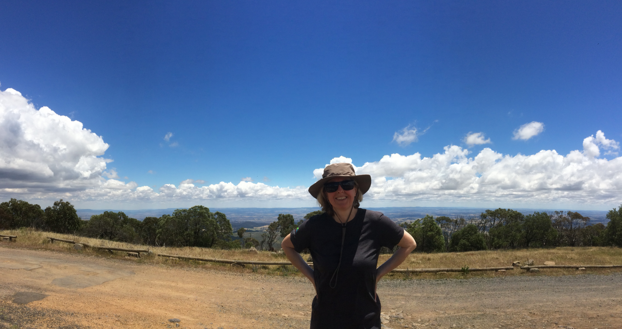
Maggie’s Random Quiz
20 totally unconnected questions
It’s a quiz and it’s random.

Slide 2
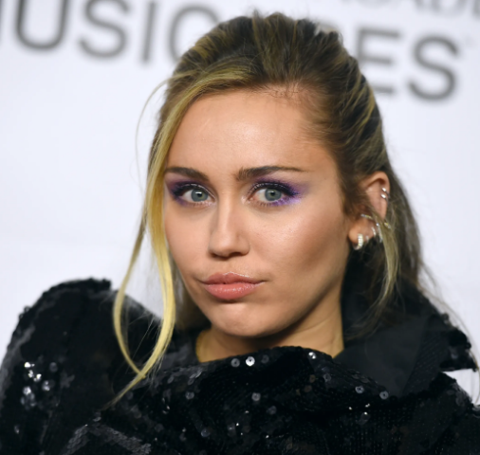
Q1
Popular culture:
Pop star, Miley Cyrus came to fame playing which TV character, in the TV series of the same name?

Slide 3
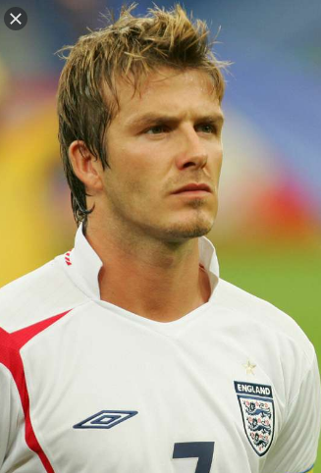
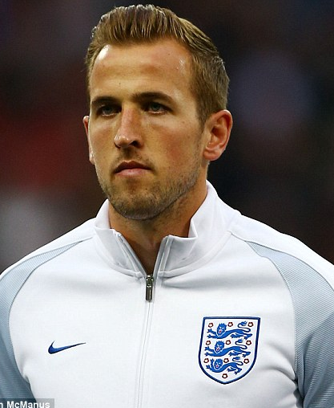
Q2
Sport – and geography:
England captains, David Beckham and Harry Kane, attended the same school in North East London.
Which London borough, originally in Essex, is the school in?

Slide 4
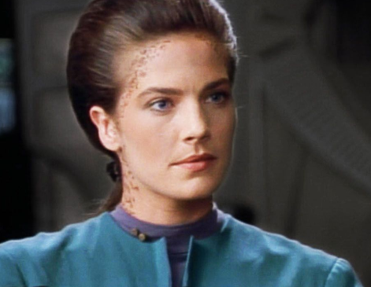
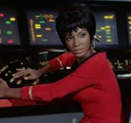
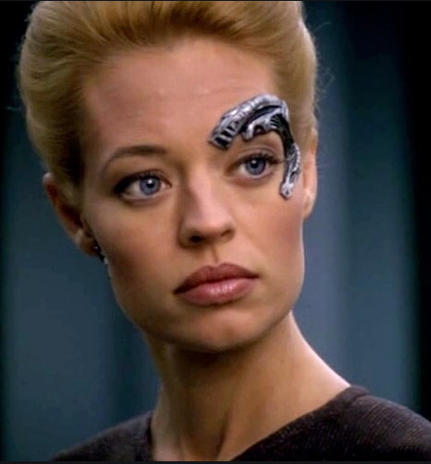
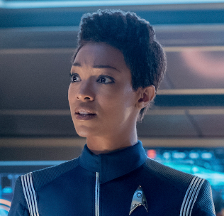
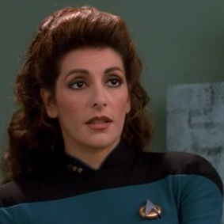
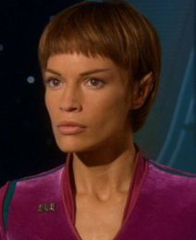
Q3
Popular culture: Match the female character to the correct Star Trek series…
1.
2
3
Star Trek: The Original Series
1.
Star Trek: Next Generation
Star Trek: Deep Space Nine
4
5
6
Star Trek: Voyager
Star Trek: Enterprise
Star Trek: Discovery

Slide 5
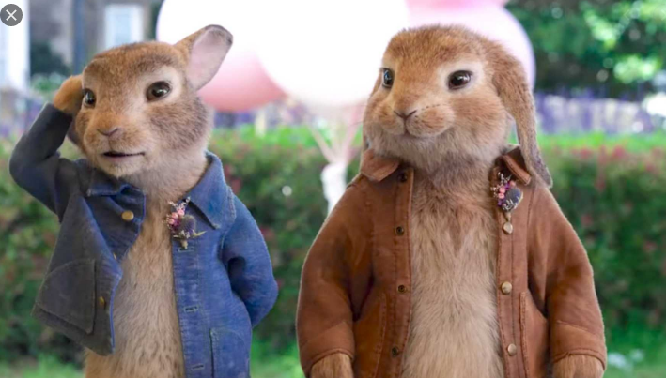
Q4
Books:
In the Beatrix Potter books, what is the name of Peter Rabbit’s arch enemy?

Slide 6
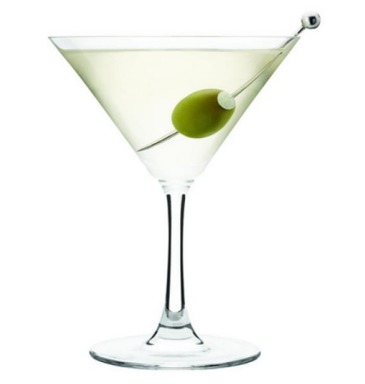
Q5
A classic Martini contains two ingredients. Which of these is the correct recipe…
a) Triple sec with either vodka or gin
b) Vermouth with either rum or vodka
c) Rum with either vodka or gin
d) Vermouth with either vodka or gin

Slide 7
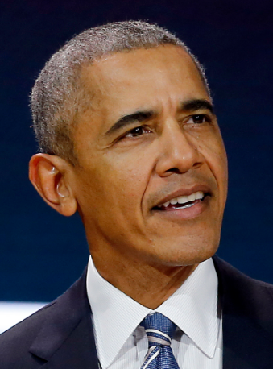
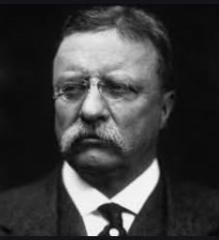
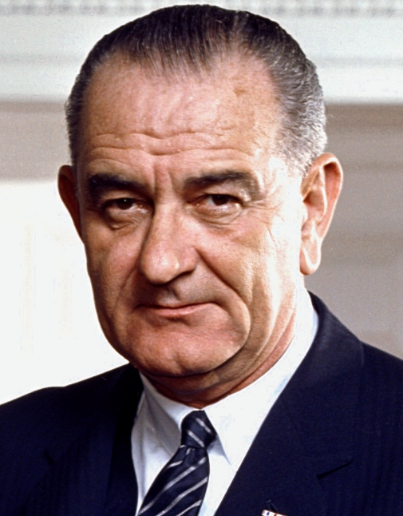
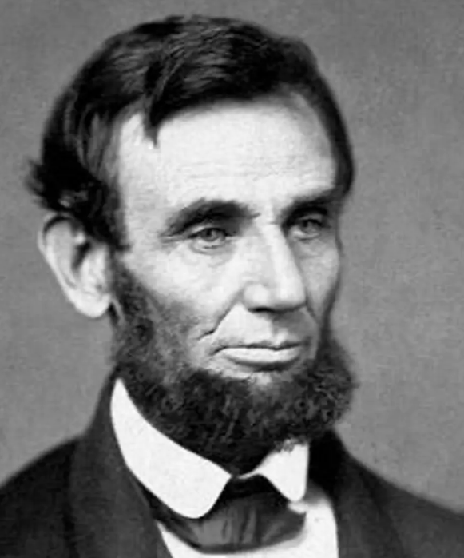
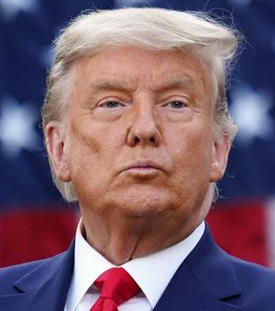
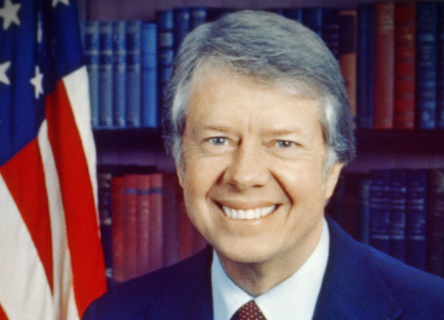
Q6
Politics: we have six US presidents and six First Ladies. Match the First Lady to the president…
1.
2
3
Mary
Lady Bird
Michelle
Rosalyn
5
6
Edith
4
Melania

Slide 8
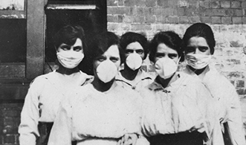
Q7
Pandemic:
Between February 1918 and April 1920, the Spanish flu infected 500 million people – about a third of the world's population at the time – in four successive waves.
To the nearest million, how many people are estimated to have died worldwide?
Nearest guess wins the point.

Slide 9

Television: Bill Bailey won Series 18 of Strictly Come Dancing – but can you remember who won Series 17, the previous year?
Q8

Slide 10
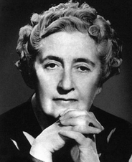
Q9
Classic Crime Fiction: Below are five well known Agatha Christie novels. Fill in the blanks in their titles:
1. Murder on the _________ Express
2. 4.50 From ______________
3. ______ Among The Pigeons
4. At __________ Hotel
5. Why Didn’t They Ask_____________

Slide 11
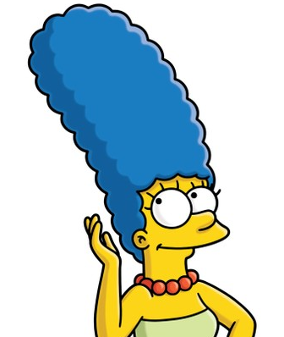
Q10
More popular culture:
In the Simpsons, what is Marge Simpson’s maiden name?
And for a second point, name the person who inspired that name.

Slide 12

Q11
Music: International electronic dance music duo,
...come from which Northern town or city?

Slide 13
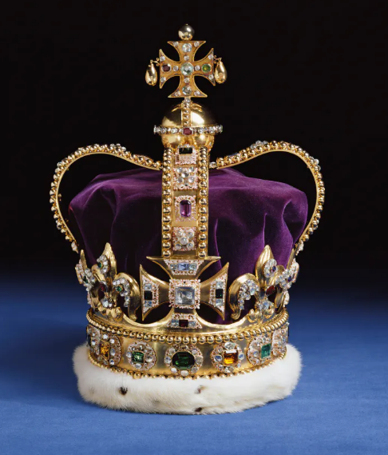
Q12
Reigning monarchs: name the nations that these six monarchs rule?
1. Prince Albert II
2. King Bhumibol Adulyadej
3. Queen Margrethe II
4. King Carl XVI Gustaf
5. King Norodom Sihamoni
6. King Philippe

Slide 14
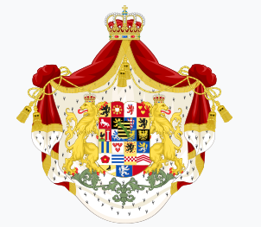

Q13
Sticking with Royalty:
The House of Windsor used to be called the House of Saxe-Coburg Gothe.
Which world event caused the name to be changed to the House of Windsor?
And, for a second point, in which year did the change take place?

Slide 15
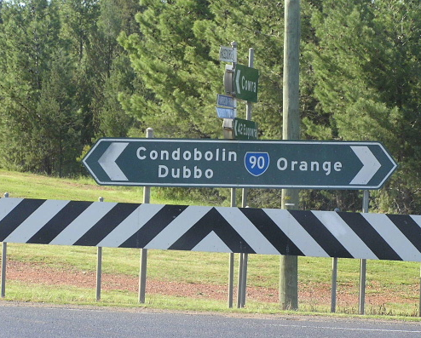
Q14
Geography multiple choice: I recently went to Orange in regional NSW. Why is the town called Orange?
a) Due to the unusual orange hue of the rocks and soil in the area
b) It is a major orange-growing region
c) The founder of the town had fought in the Peninsula Wars with William of Orange
d) It was the site of a collision between two drovers’ carts, one carrying red pigment, one carrying yellow pigment

Slide 16
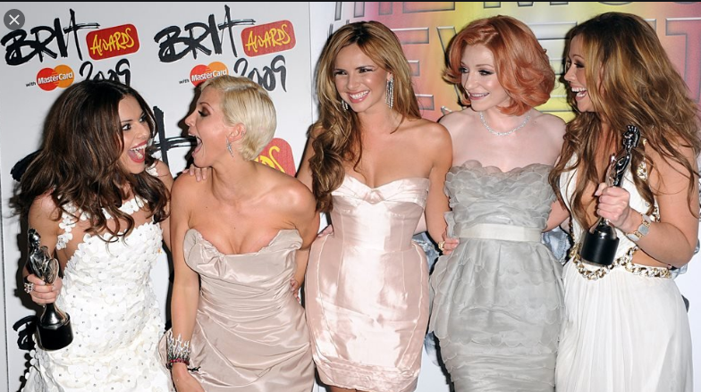
Q15
Pop music: Cheryl Cole’s solo career versus Girls Aloud and who sold the more records: place the following five hits in order, biggest seller first:
a) Girls Aloud: Love Machine
b) Cheryl Cole: Fight For This Love
c) Girls Aloud: The Promise
d) Girls Aloud: Sound Of The Underground
e) Cheryl Cole: Call My Name

Slide 17
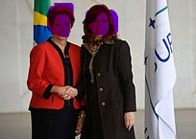
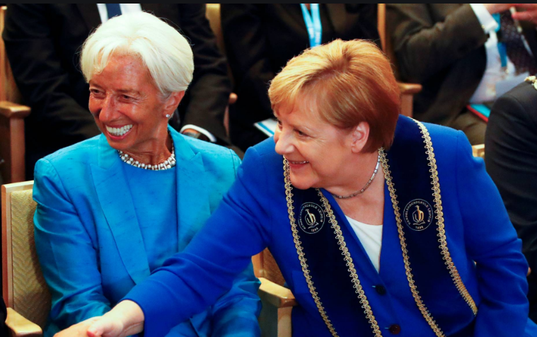
Q16
?
?
How many current Heads of State (that is Prime Ministers or Presidents) are women?
Nearest guess wins the point.
?
?

Slide 18
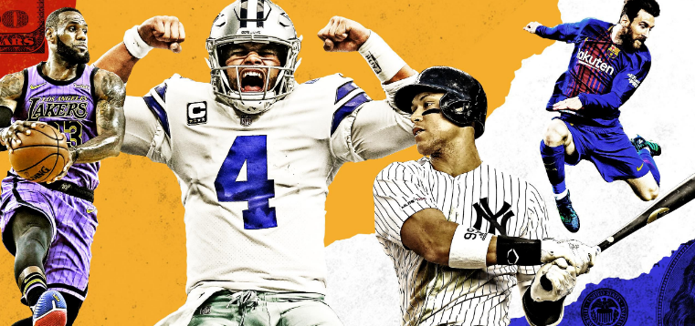
Q17
Sport: match these six North American sports teams to the correct nickname…
1. LA
a) Dash
2. Toronto
b) Packers
3. Minnesota
c) Blue Jays
4. Green Bay
d) Briuns
e) Galaxy
5. Boston
6. Houston
f) Timberwolves

Slide 19
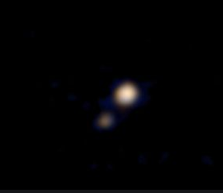
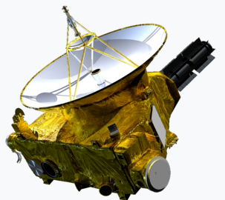
Q18
The New Horizons space probe was launched by NASA in 2006 to explore the furthest reaches of our Solar System and beyond.
Pluto
How many years was it projected it would take for New Horizons to reach Pluto?
Nearest guess wins the point.

Slide 20
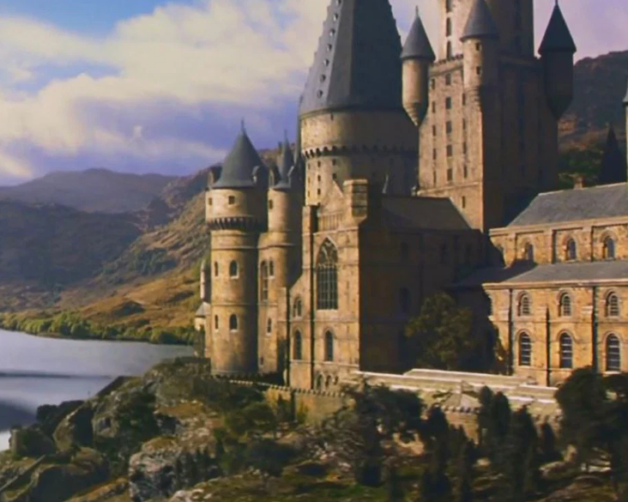
Q19
Books and movies:
In Harry Potter, name the four Houses of Hogwarts
A point for each one you get right.

Slide 21

Q20
And finally, in the FA Cup Third Round this year Tottenham Hotspurs played non-league Marine AFC who are a record EIGHT DIVISIONS below them.
…but where exactly IS Marine AFC based?

Slide 22
That is the end
Here come the answers…

Slide 23
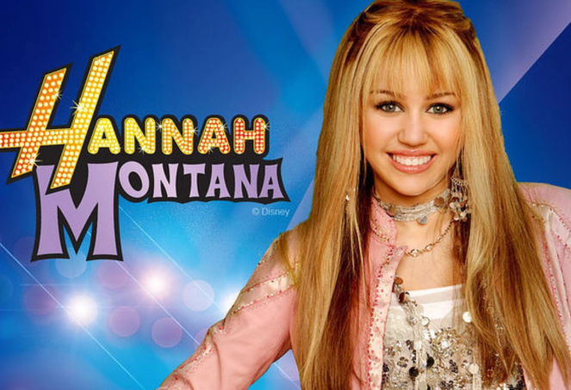
Q1
Popular culture:
Pop star, Miley Cyrus came to fame playing which TV character, in the TV series of the same name?

Slide 24
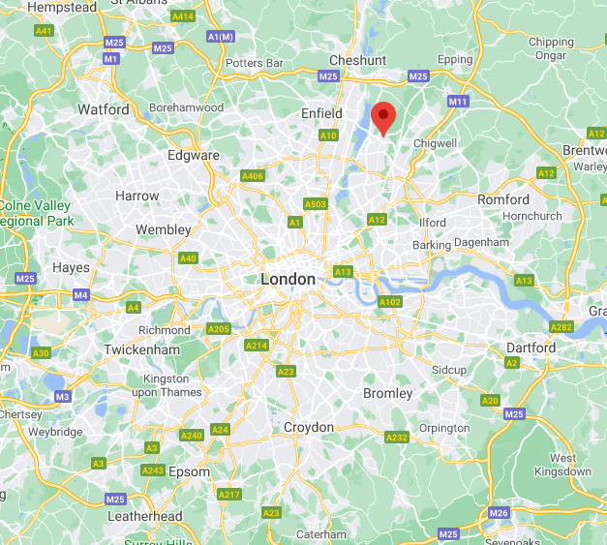
Q2
Sport:
England captains, David Beckham and Harry Kane, attended the same school in North East London.
Name the London borough, originally in Essex , that the school is in.
CHINGFORD

Slide 25
Q3
Match the female character to the correct Star Trek series…
2
3
1.
Star Trek: The Original Series
Star Trek: Next Generation
Star Trek: Deep Space Nine
Star Trek: Voyager
5
6
4
Star Trek: Enterprise
Star Trek: Discovery

Slide 26
Q3
Match the female character to the correct Star Trek series…
1.
2
3
Deep Space Nine
The Original Series
Voyager
4
5
6
Next Generation
Enterprise
Discovery
1 point for each one you got correct

Slide 27
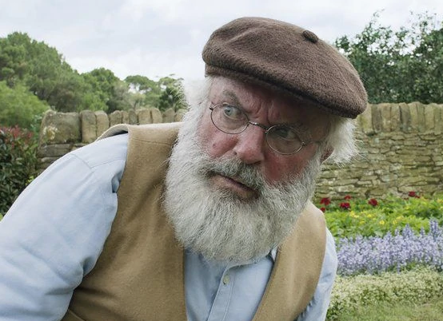
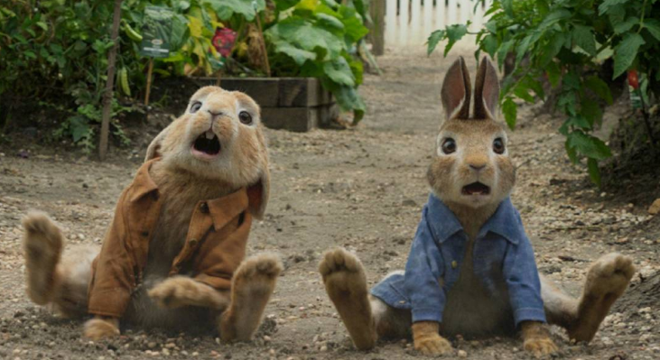
Q4
Books:
In the Beatrix Potter books, what is the name of Peter Rabbit’s arch enemy?
Mr McGregor

Slide 28
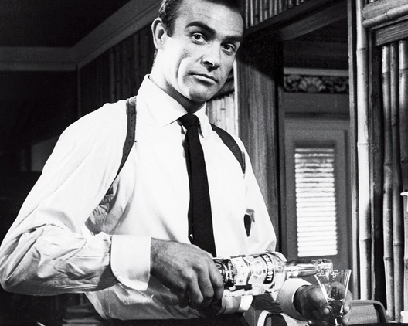
Q5
A classic Martini contains two ingredients. Which of these is the correct recipe…
Shaken not stirred
a) Triple sec with either vodka or gin
b) Vermouth with either rum or vodka
c) Rum with either vodka or gin
d) Vermouth with either vodka or gin

Slide 29
Q6
Match the First Lady to the correct US President…
1.
2
3
Mary
Lady Bird
Michelle
Rosalyn
5
6
Edith
4
Melania

Slide 30
Q6
Match the First Lady to the correct US President…
Lady Bird
Barack Obama
1.
Theodore Roosevelt
2
3
Michelle
Linden B Johnson
Edith
Abraham Lincoln
5
6
Jimmy Carter
4
That idiot man
1 point for each one you got correct
Rosalyn
Mary
Melania

Slide 31
Q7
Pandemic:
Between February 1918 and April 1920 the Spanish flu infected 500 million people – about a third of the world's population at the time – in four successive waves.
To the nearest million, how many people are estimated to have died worldwide?
The death toll is typically estimated to have been somewhere between 17 million and 50 million.
If you guessed anywhere between 17 and 50 million you get a point.

Slide 32
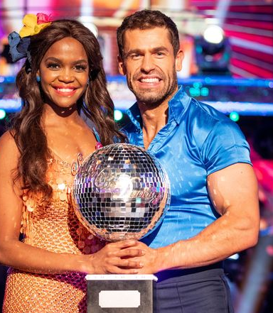
Television: Bill Bailey won Series 18 of Strictly Come Dancing – but can you remember who won Series 17, the previous year?
Q8
Kelvin Fletcher

Slide 33
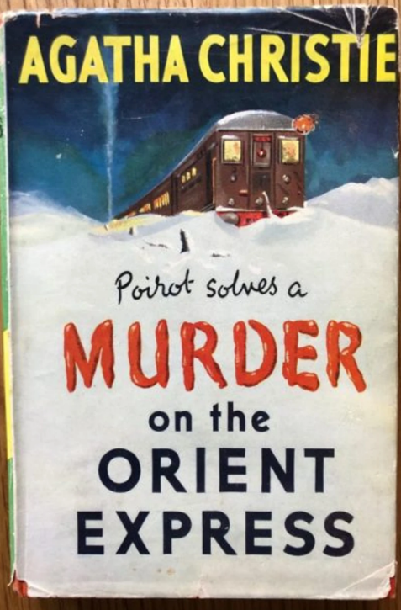

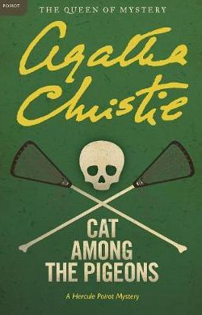

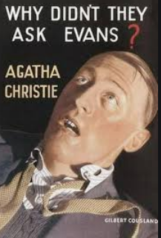
Q9
Classic Crime Fiction: Below are five well known Agatha Christie novels. Fill in the blanks in their titles:
Orient
1. Murder on the _________ Express
Paddington
2. 4.50 From ______________
Cat
3. ______ Among The Pigeons
Bertram’s
4. At __________ Hotel
Evans
5. Why Didn’t They Ask_____________
1 point for each one you got correct

Slide 34
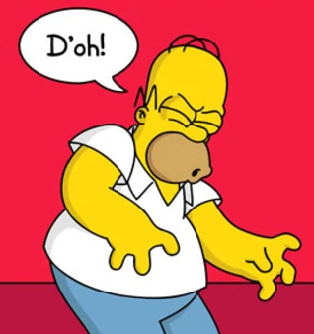
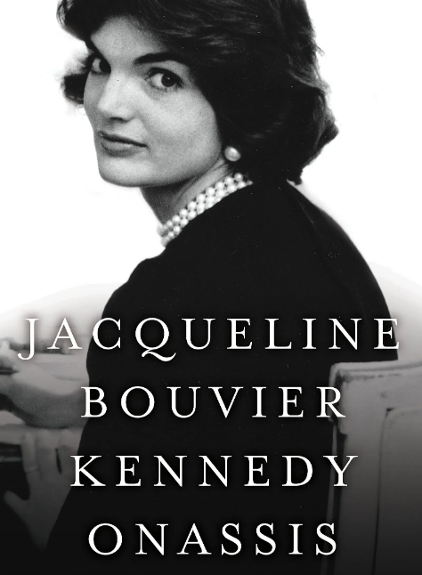
Q10
More popular culture:
In the Simpsons, what is Marge Simpson’s maiden name?
And for a second point, name the person who inspired that name.
Bouvier
Jacqueline Kennedy Onassis née Bouvier

Slide 35
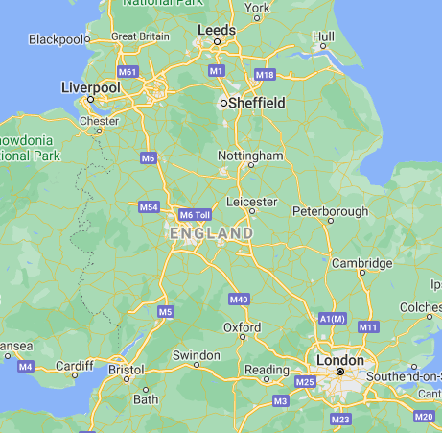
Q11
International electronic dance music duo,
...come from which Northern town or city?

Slide 36
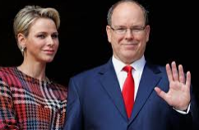
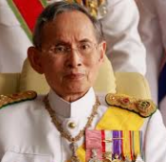
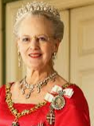
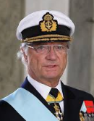
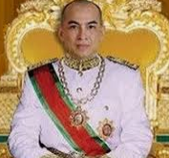
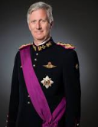
Q12
Reigning monarchs: name the nation that these six monarchs rule?
1. Prince Albert II
Monaco
2. King Bhumibol Adulyadej
Thailand
3. Queen Margrethe II
Denmark
4. King Carl XVI Gustaf
Sweden
5. King Norodom Sihamoni
Cambodia
6. King Philippe
Belgium
1 point for each one you got correct

Slide 37

Q13
The House of Windsor used to be called the House of Saxe-Coburg Gothe.
Which world event caused the name to be changed to Windsor?
And for a second point, in what year?
TOO GERMAN
The First World War
1917
1 point for each one you got correct

Slide 38
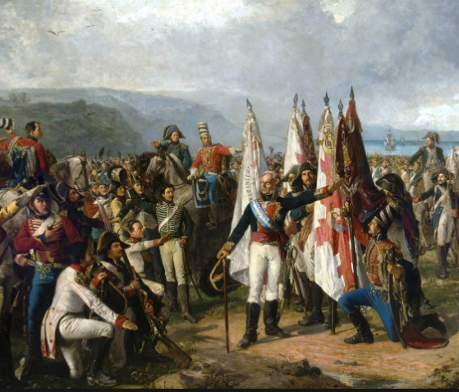
Q14
Geography: I recently went to Orange in regional NSW. Why is the town called Orange?
In 1829 Major Thomas Mitchell named the site of the new town ‘Orange’ as he had been an associate of the Prince of Orange in the Peninsular War.
a) Due to the unusual orange hue of the rocks and soil in the area
b) It is a major orange-growing region
c) The founder of the town had fought in the Peninsula Wars with William of Orange
d) It was the site of a collision between two drovers’ carts, one carrying red pigment, one carrying yellow pigment

Slide 39
Q15
Pop music: Cheryl Cole’s solo career versus Girls Aloud and who sold the more records: place the following five hits in order, biggest seller first:
a) Girls Aloud: Love Machine
b) Cheryl Cole: Fight For This Love
c) Girls Aloud: The Promise
d) Girls Aloud: Sound Of The Underground
e) Cheryl Cole: Call My Name

Slide 40

Q15
Pop music: Cheryl Cole’s solo career versus Girls Aloud and who sold the more records: place the following five hits in order, biggest seller first:
No pet.
I know It’s us – we sold more!
b) Cheryl Cole: Fight For This Love
d) Girls Aloud: Sound Of The
Underground
c) Girls Aloud: The Promise
e) Cheryl Cole: Call My Name
a) Girls Aloud: Love Machine
1 point for each one you got correct

Slide 41


Q16
Gott im Himmel…
?
?
How many current Heads of State (that is Prime Ministers or Presidents) are women?
There are currently 25 female heads of state…
…which is still only 12.8% of all current heads of state.
Nearest guess wins the point.

Slide 42
Q17
Sport: match these six North American sports teams to the correct nickname…
1. LA
a) Dash
2. Toronto
b) Packers
3. Minnesota
c) Blue Jays
4. Green Bay
d) Briuns
e) Galaxy
5. Boston
6. Houston
f) Timberwolves

Slide 43






Q17
Sport: match these six North American sports teams to the correct nickname…
1. LA
soccer (NSL)
e) Galaxy
c) Blue Jays
baseball
2. Toronto
f) Timberwolves
basketball
3. Minnesota
b) Packers
4. Green Bay
American football
d) Briuns
ice hockey
5. Boston
a) Dash
soccer (NWSL)
6. Houston
A point for each one you got right.

Slide 44

Q18
Pluto
The New Horizons space probe was launched by NASA in 2006 to explore the furthest reaches of our Solar System and beyond.
How many years was it projected it would take for New Horizons to reach Pluto?
9 years.
New Horizons flew past Pluto between July and October 2015.
Nearest guess wins the point.

Slide 45





Q19
Books and movies:
In Harry Potter, name the four Houses of Hogwarts
Gryffindor
Hufflepuff
Ravenclaw
Slytherin
A point for each one you got right.

Slide 46


Q20
In the FA Cup Third Round this year Tottenham Hotspurs played non-league Marine AFC…
Crosby
…but where exactly IS Marine AFC based?
If you said Crosby, Merseyside or Liverpool you get a point.

Slide 47
That’s it
How did you do?

